Slide 1

Speech Recognition App
Created by: John Le
Created on: 07/26/2023 (Summer Session)
Class: CMPR114 Python Programming

Slide 2
Objectives:
The two main objectives of the Python application:
The ability to transcribe dictations into text.
The ability to save the text to a text file or database table.

Slide 3
Application Dependencies:
Current Implementation:
Tkinter
Messagebox
FileDialog
Speech Recognition
Pyodbc
PyAudio
Other considerations:
Vosk – Multiple threading model and queueing mechanism made it a bit complex.
AssemblyAI – Robust library but takes more knowledge to implement.
Whisper API, Houndify, Azure Speech, Wit.ai

Slide 4
High Level Application Flow

Slide 6
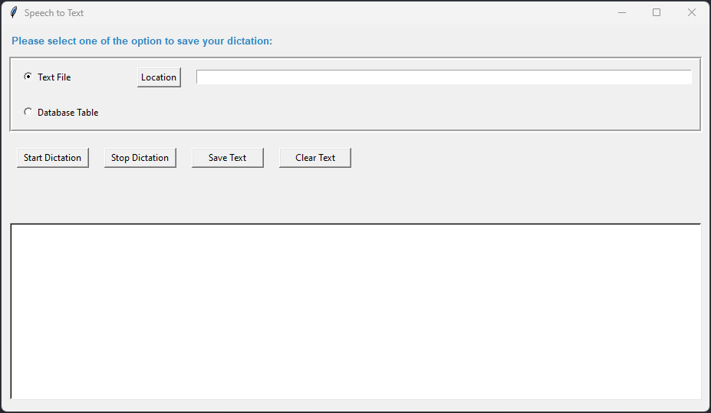
Application Component
Option to save dictation to text file
Specify preferred location of text file
Option to save dictation to database table
Hidden label showing the status of dictation
Display the dictation in text

Slide 7
Challenges:
Determining the best speech recognition library to use
Implemented Speech Recognition library has slight delay in generating text, while others require high CPU utilization or API references.
Button to stopping the dictation was problematic since the dictation was running in a continuous loop
Display the text coming back from speech recognition and displaying it into the text/label widget.
No examples of tkinter widgets integrating with speech recognition.

Slide 8
Retrospect
In hind sight, the project was an excellent opportunity to put my new technical knowledge into real-life application. Looking back, here are some of the things I would have like to do better:
Segregation of code based upon functionality
Better Error Handling
Understanding of Python standards and best practices
Opportunity to deploy code to various staging environments (DEV, QA, STAGE, PROD)

